Slide 1
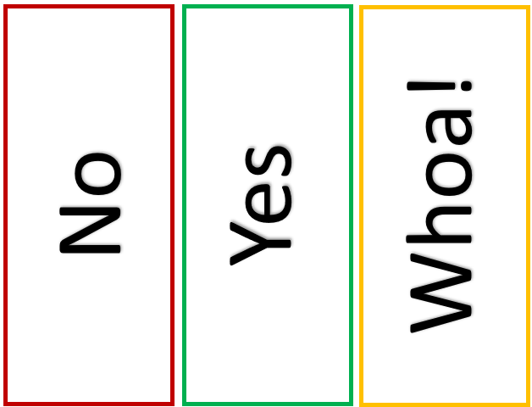

Yes, No, Whoa Activity Information
How: print out cards OR have students do thumbs up/down or sideways OR use online polling/chat function on Teams
Example goal: increase understanding of course’s AI policy
Side effects: create student buy-in
Think about a specific class policy and brainstorm how GAI could be used
Alt: have students design statements

Slide 2
Yes, No, Whoa Activity
Think about the statement and if you agree with it, you’d respond yes, do not agree (no) and if you need to break it down further (whoa).
Warm-up Statements:
Coffee should be its own food group
Dogs are better than cats

Slide 3
Yes, No, Whoa Activity Statements
    It’s fine if students use AI to rewrite their rough drafts for grammar and clarity.
    Students can use AI to write their entire discussion post—as long as they agree with it
    Students should always disclose when they used AI for any part of an assignment.
    AI should be taught like a research tool—like how we teach databases or citation software.
    It’s the student’s responsibility to know when AI use crosses the line into dishonesty.
    If a student uses AI to summarize a reading, they don’t need to read it themselves
    Faculty should provide examples of acceptable & unacceptable AI use in each assignment
    AI can help some students express themselves better than they could on their own

